Slide 1
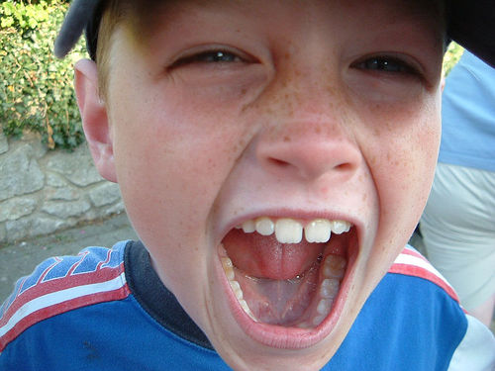
Shout it out!

Slide 2
A sport or a game
. . . . . . . . . . . .
B

Slide 3
Something green
. . . . . . . . . . . .
F

Slide 4
A shop
. . . . . . . . . . . .
M

Slide 5
A food
. . . . . . . . . . . .
C

Slide 6
A fruit or vegetable
. . . . . . . . . . . .
P

Slide 7
Something white
. . . . . . . . . . . .
P

Slide 8
A colour
. . . . . . . . . . . .
W

Slide 9
Something you can keep in a garage
. . . . . . . . . . . .
B

Slide 10
A computer game
. . . . . . . . . . . .
N

Slide 11
An item of clothing
. . . . . . . . . . . .
R

Slide 12
A drink
. . . . . . . . . . . .
L

Slide 13
A boy’s name
. . . . . . . . . . . .
S

Slide 14
Something you can do in a park
. . . . . . . . . . . .
D

Slide 15
Something you can do on holiday
. . . . . . . . . . . .
C

Slide 16
A film title
. . . . . . . . . . . .
V

Slide 17
An animal
. . . . . . . . . . . .
W

Slide 18
A word ending in “E”
. . . . . . . . . . . .
T

Slide 19
A country
. . . . . . . . . . . .
D

Slide 20
A girl’s name
. . . . . . . . . . . .
D

Slide 21
A job
. . . . . . . . . . . .
H

Slide 22
A pop star
. . . . . . . . . . . .
MJ

Slide 23
A TV show
. . . . . . . . . . . .
YBF

Slide 24
An town or city in England
. . . . . . . . . . . .
M

Slide 25
Something you do at school
. . . . . . . . . . . .
H

Slide 26
A round object
. . . . . . . . . . . .
P

Slide 27
A type of dog
. . . . . . . . . . . .
JR

Slide 28
Something you can have in a sandwich
. . . . . . . . . . . .
H

Slide 29
Something you can smell
. . . . . . . . . . . .
S

Slide 30
Somewhere you can go out to for the day
. . . . . . . . . . . .
Z

Slide 31
A person from the Bible
. . . . . . . . . . . .
A

